Slide 1


Specially for
A glimpse and impact of
Presented by: Faris Basharahil,
Chief Executive and Board Member

Slide 2

OVERVIEW

Slide 3
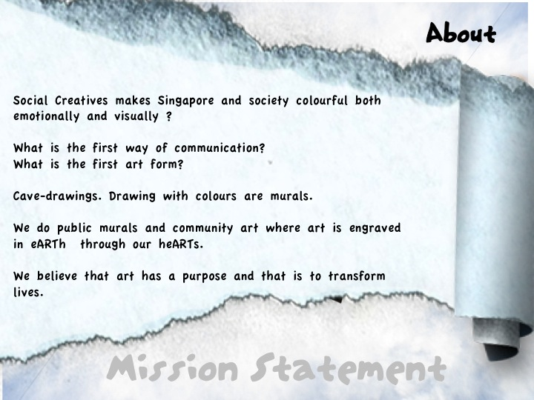

Slide 4
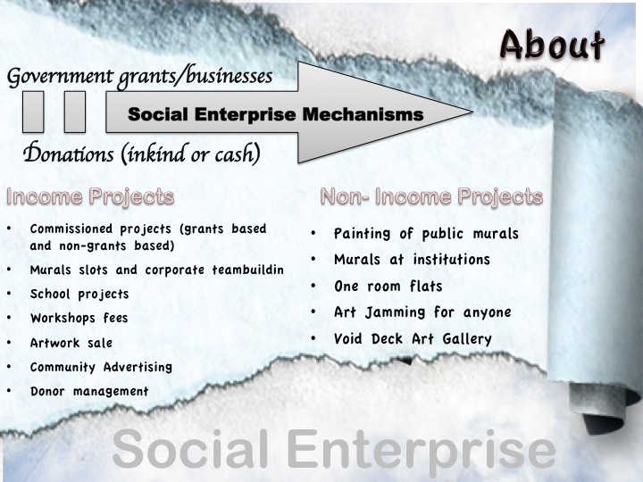
Notes:
Give a man a fish exercise

Slide 5
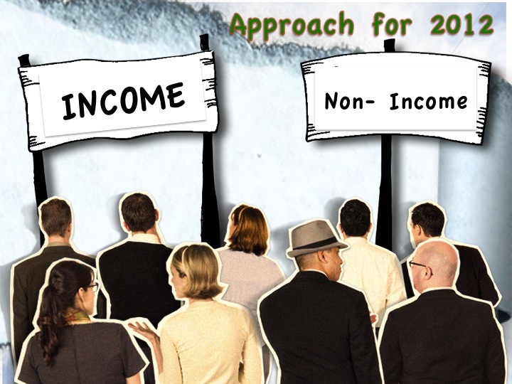

Slide 6
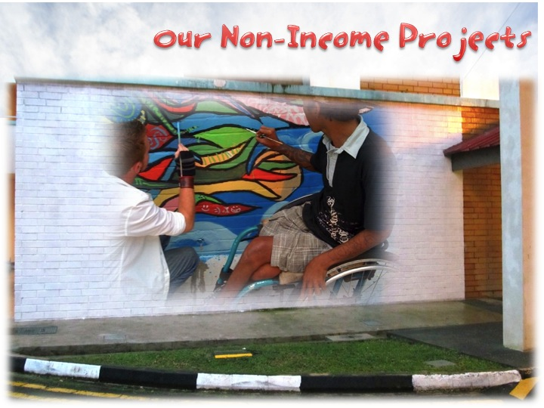
Notes:
A picture speaks a thousand words exercise.

Slide 7
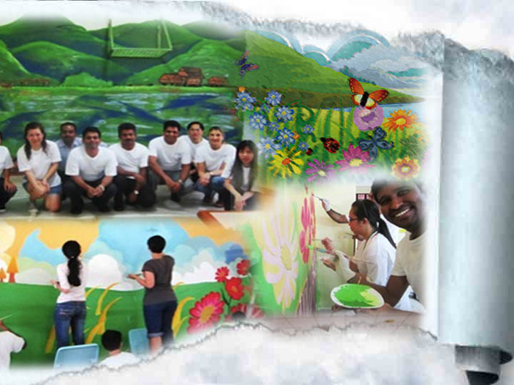

Slide 8
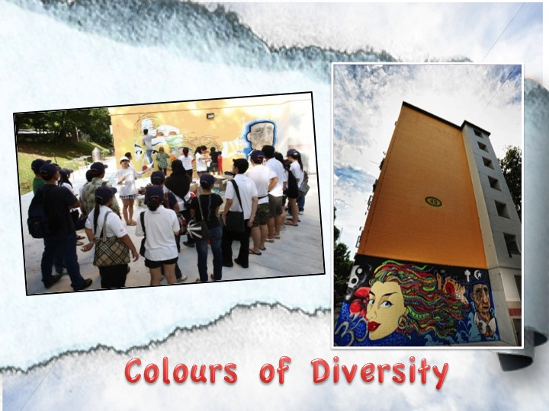

Slide 9

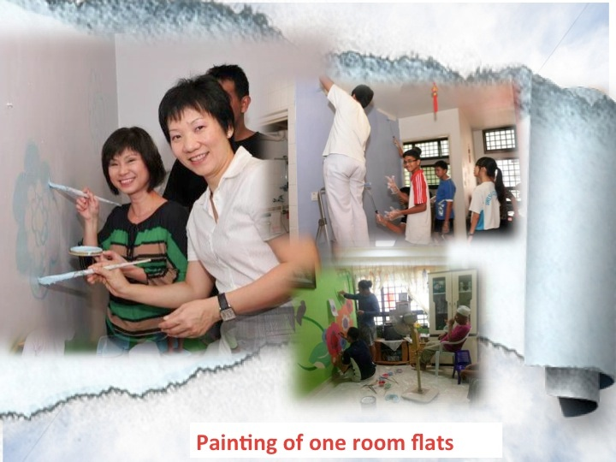
Painting of Needy Flats

Slide 10
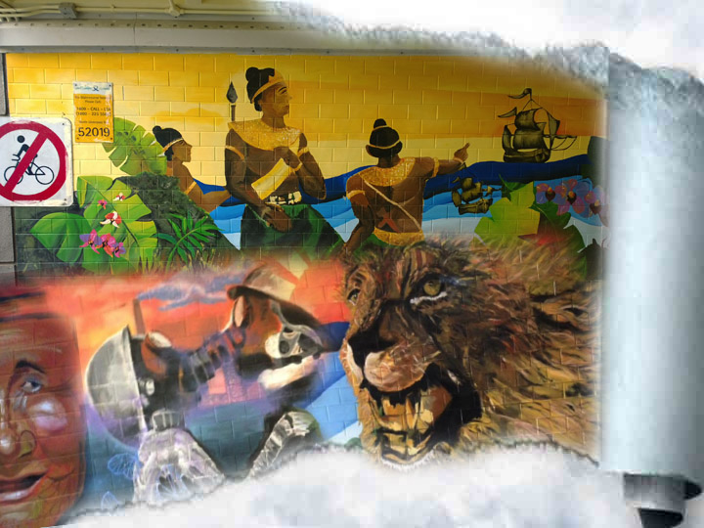

Public: Tunnels
Notes:
A recent project was at Singapore River Tunnel. Our installation worked with Singapore International Foundation about the Singapore Story

Slide 11
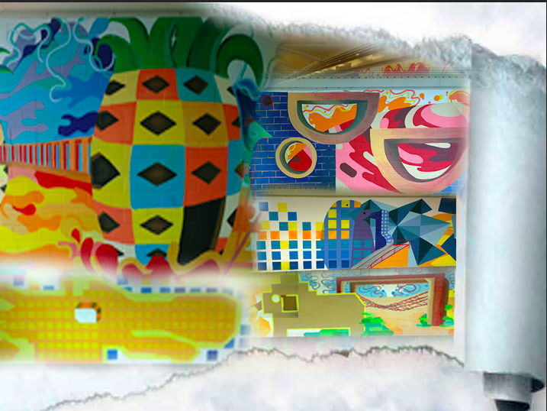
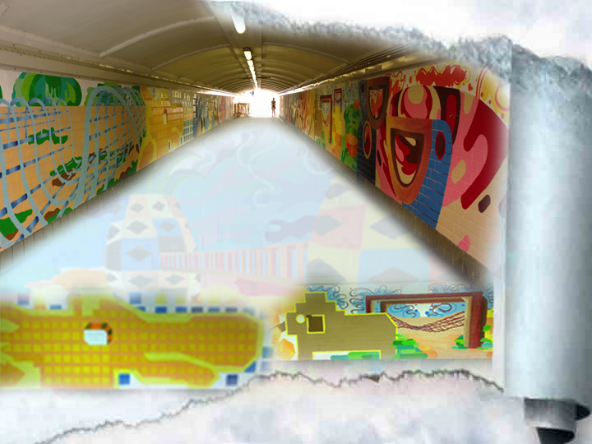
Public: Tunnels
Notes:
Social Creatives also initiated our own design for another tunnel. We choosed playgrounds of the past.

Slide 12
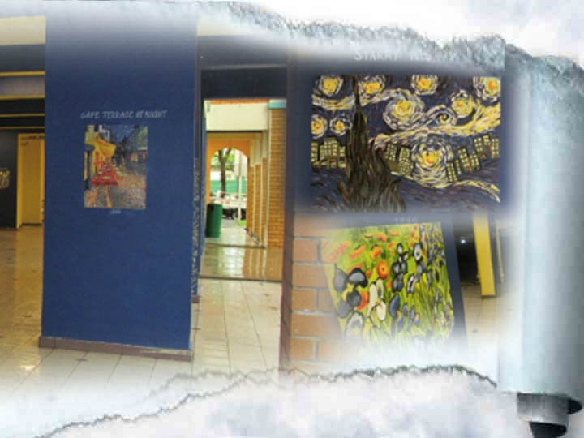
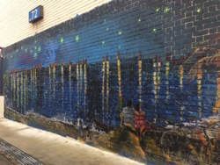
Public: VDGs
Notes:
SC has done over 150murals all over. We asked ourselves what’s next.
We decided to transform void decks into art galleries
The first one was themed to Van Gogh artworks but with singapore ingredients.
Starry night has hdb flats in the background

Slide 13
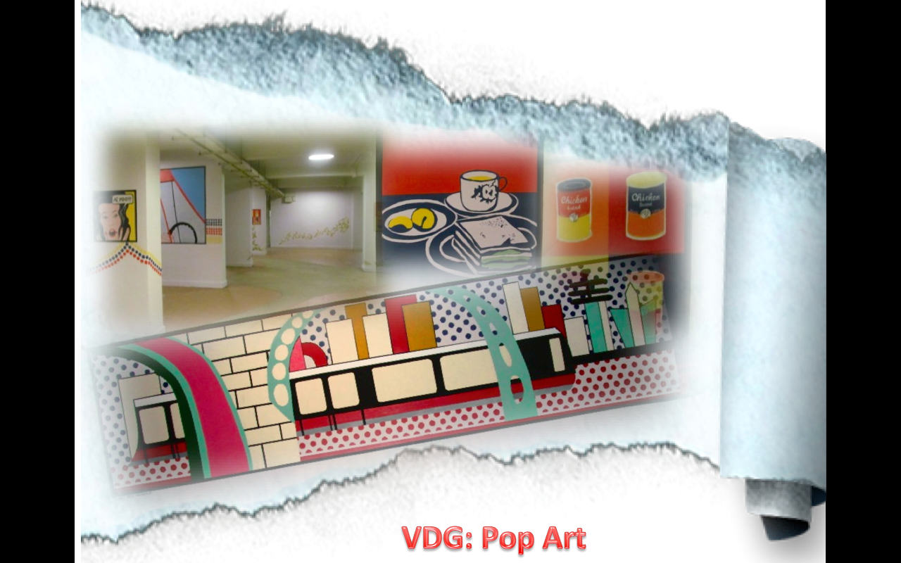
Notes:
The second VGD was Singapore messages in the style of famour pop artists.
Instead of andy warhol’s cambell soup. We have ayam brand soup. Instead of marilyn monroe we have Mrs Phua Chu Kang

Slide 14
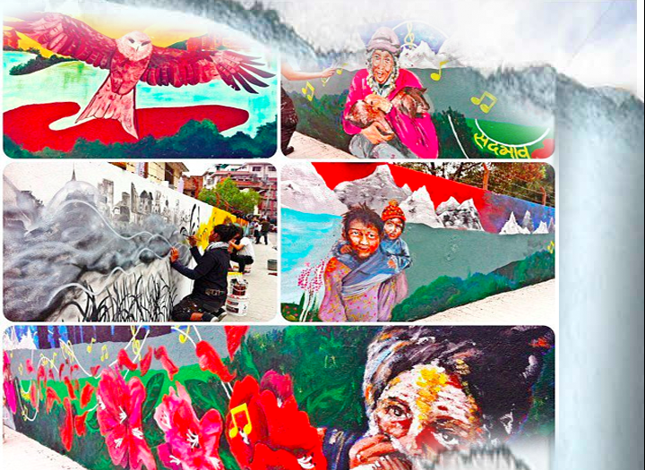
Kathmandu, Nepal 2013

Slide 15
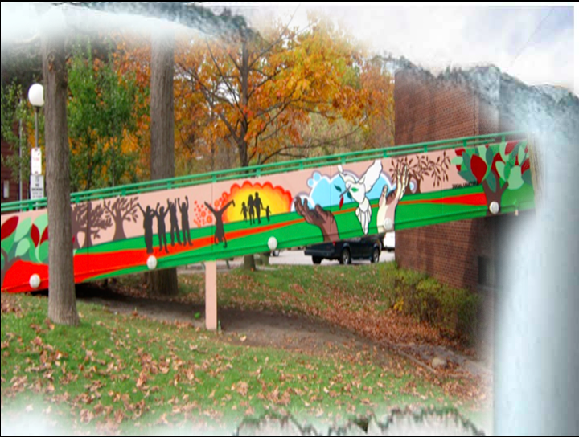
Toronto, Canada 2010

Slide 16
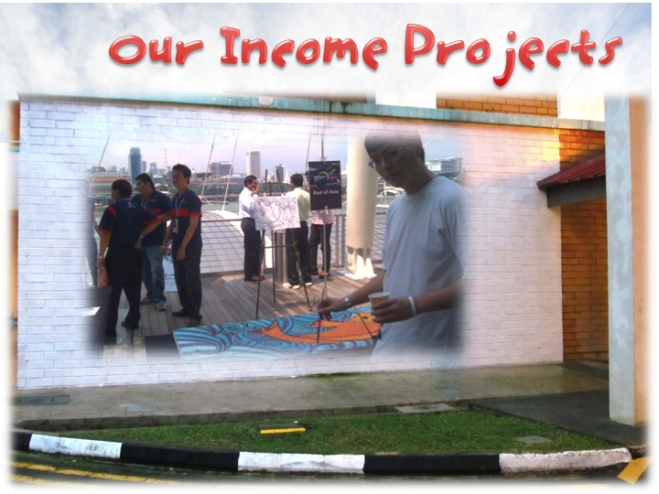

Slide 17
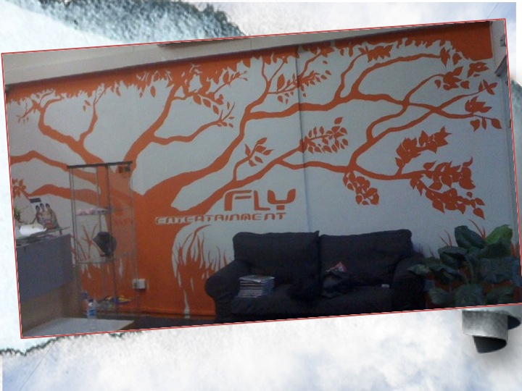
Office murals and artworks
Notes:
Fly Entertainment wanted an artwork that presented nurturing talents.

Slide 18
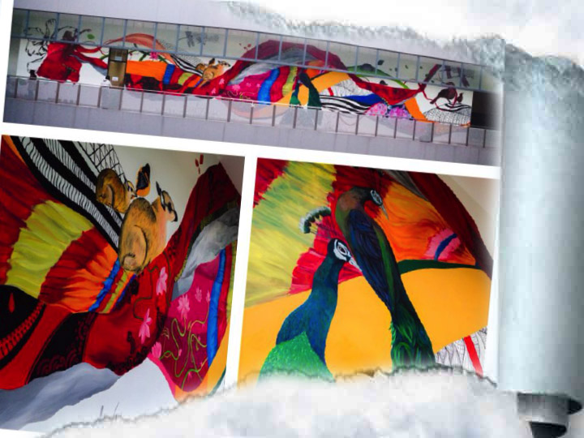
Private: DBS Gateway Asia
Notes:
DBS bank slogan is living breathing asia.

Slide 19
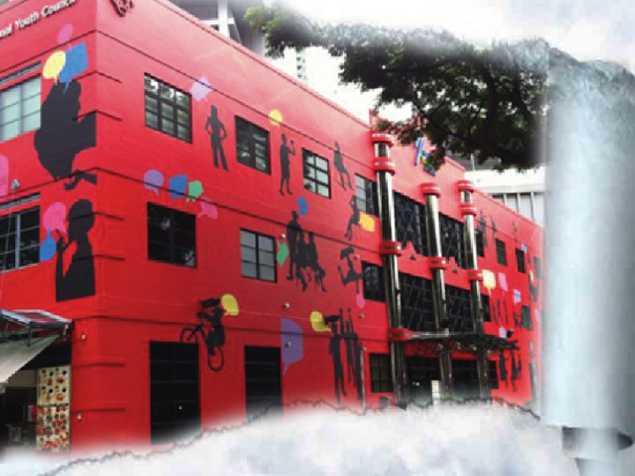
Public: *Scape
Notes:
This is our largest painted project and it represents a space of possibilities

Slide 20
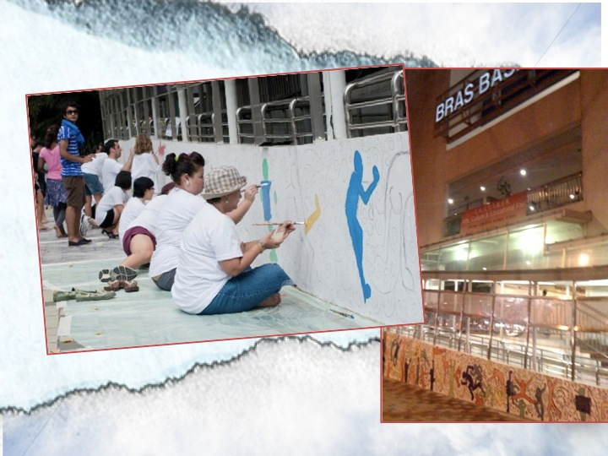
Corporate teambuilding
Notes:
Ongoing mural sessions to paint either at public walls or social service centres.

Slide 21
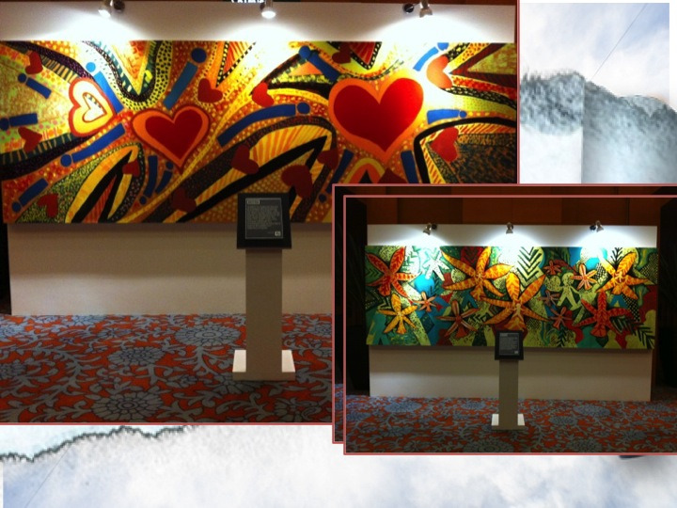
Commission Artworks
Notes:
Adoption of artworks by Deutche Bank. Now at one Marina Bay Link

Slide 22
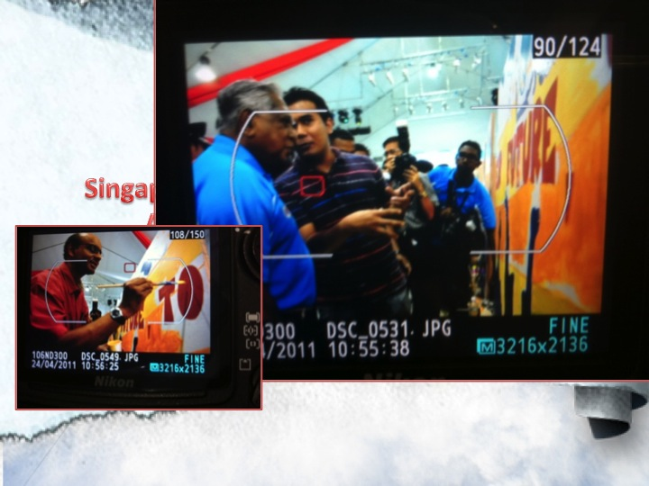
Commission records
Notes:
Broek Singapore book of records for the most number of people painted together

Slide 23
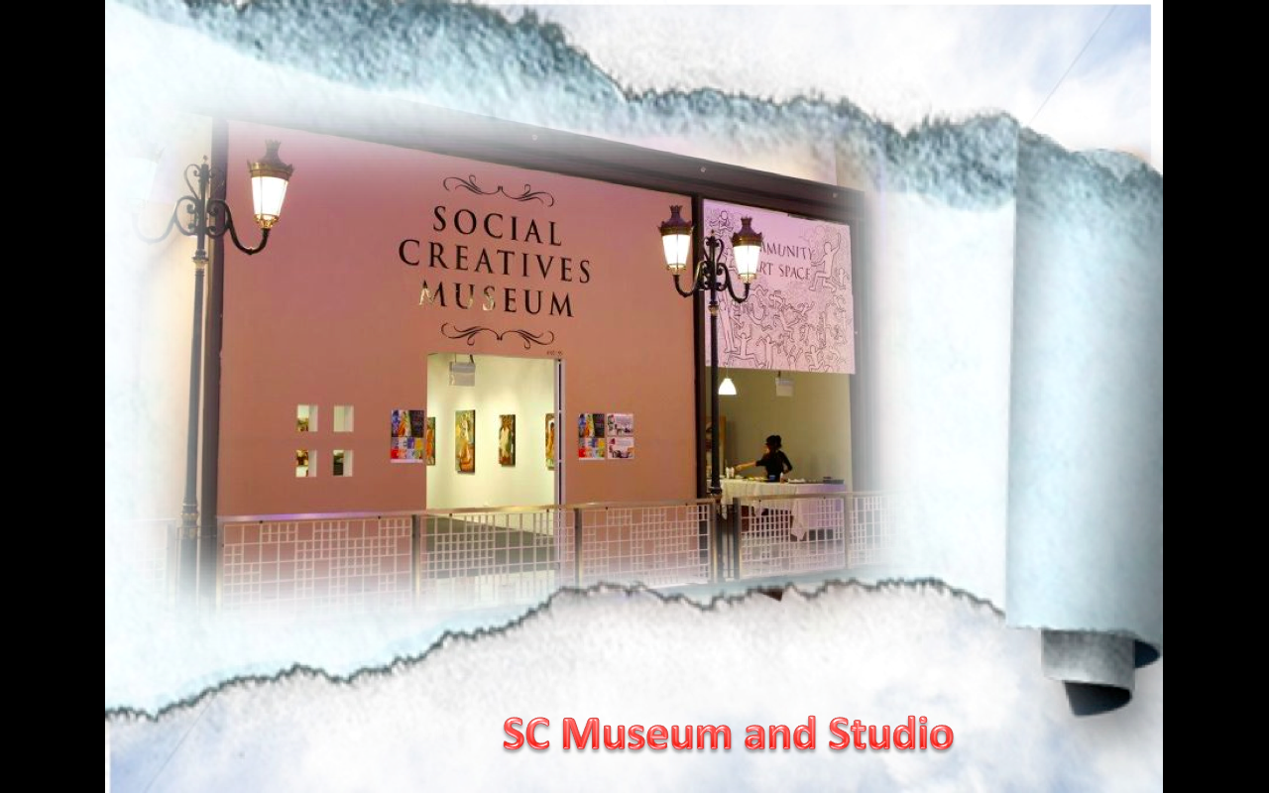

Slide 24
Murals
transform
lives

Slide 25
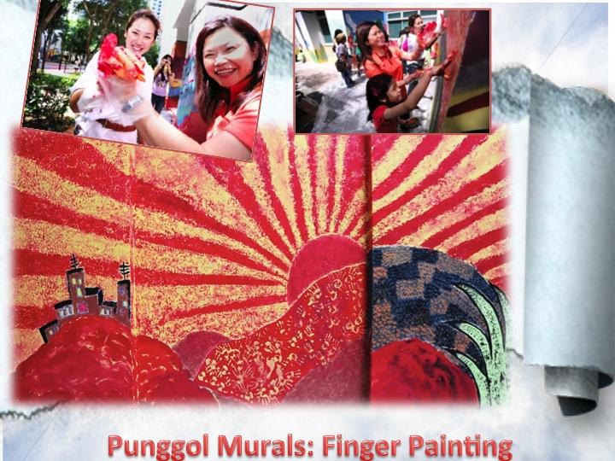

Slide 26
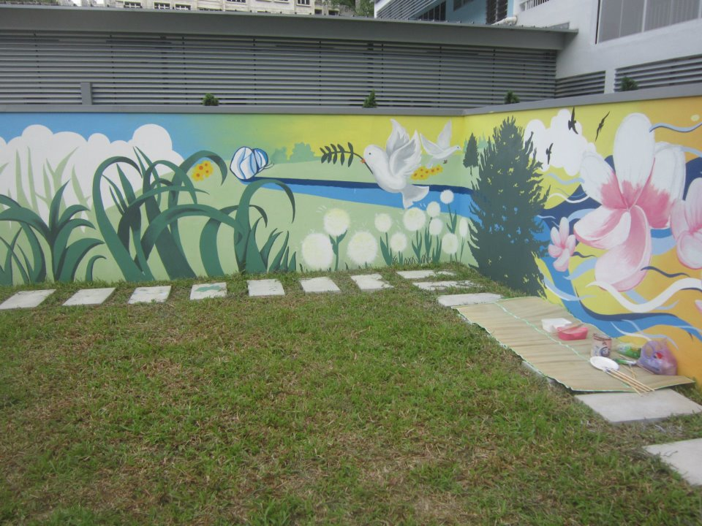
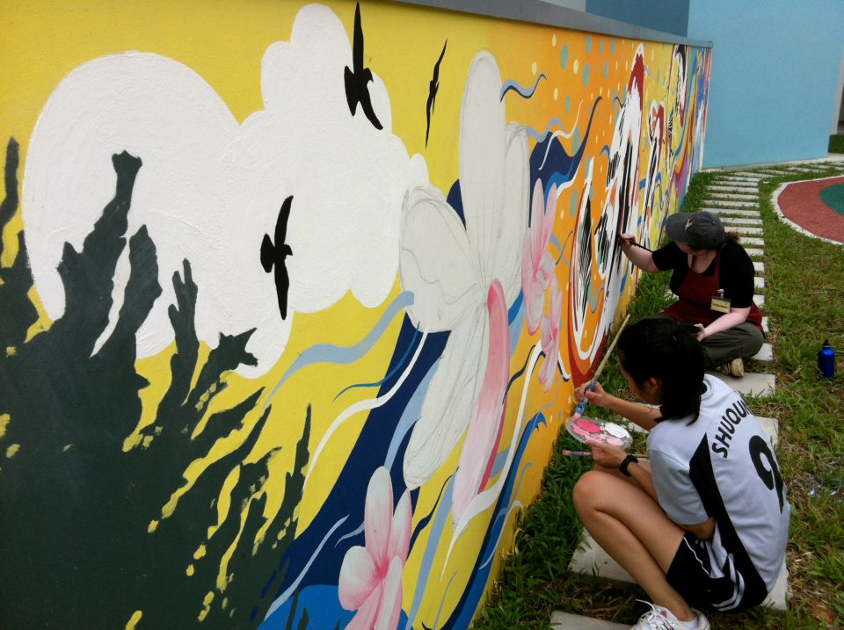
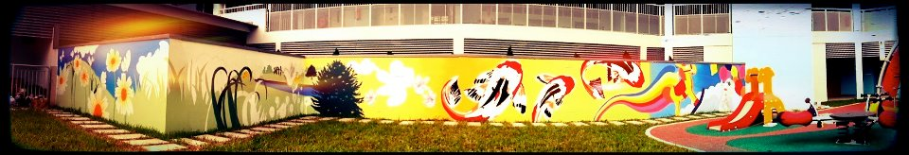
Women’s shelter for abused cases

Slide 27
Loves art but was not smart enough to learn in secondary school. Art is only offered to the top classes.
Drop out from ITE as studying is boring
Started as a part time Gallery Sitter in Social Creatives but one day she opened the Gallery late…….
Renny’s Story

Slide 28
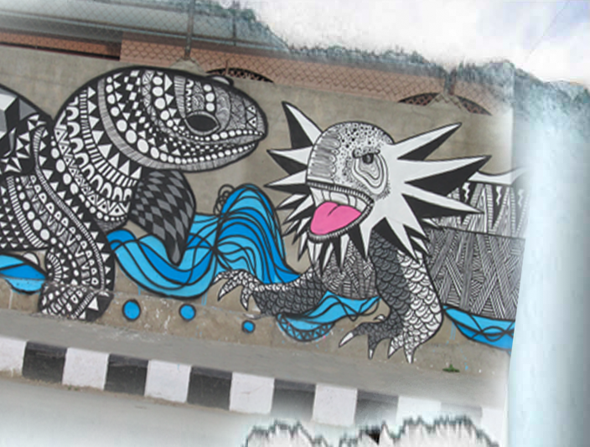
Kathmandu, Nepal 2013

Slide 29
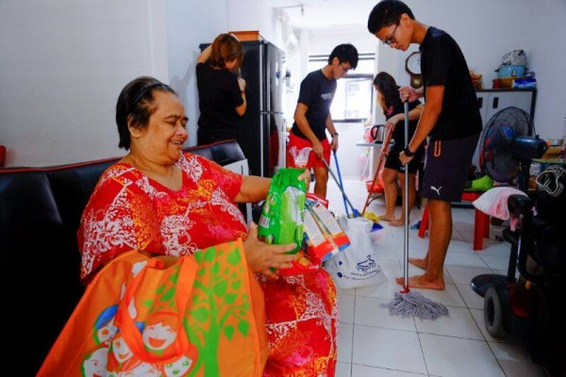
Madam Aini

Slide 30
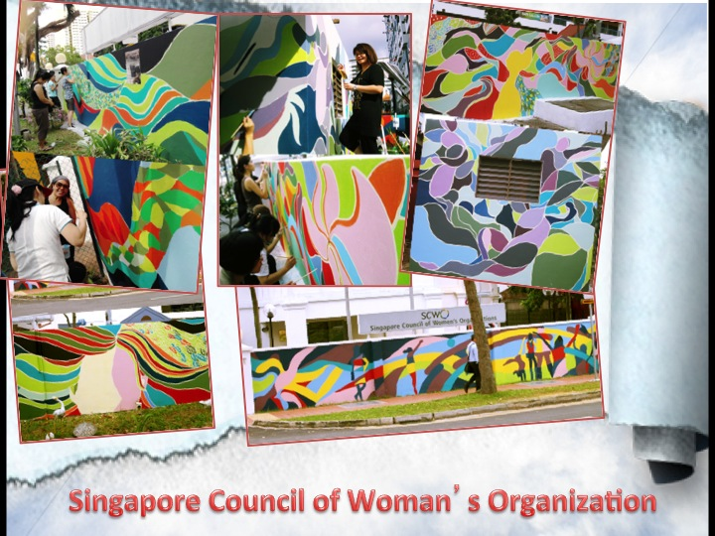
Notes:
International women’s day.

Slide 31
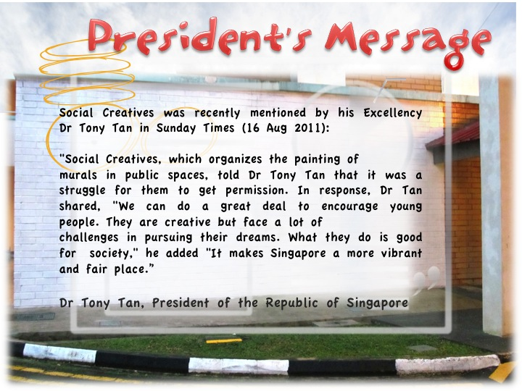

Slide 32
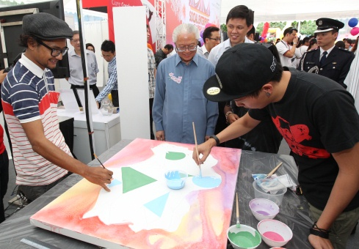
Sandwiched by policies
Art or community?
We just want to do art to make people happy
Impact analysis showed $1 where SC received leads to $96 of impact
The reality

Slide 33
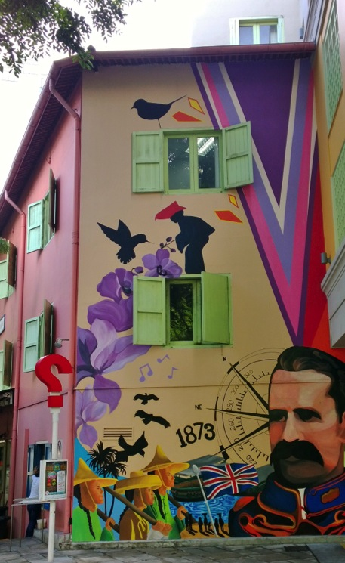
Be a donor:
$500 we can paint a one room flat
www.socialcreatives.com
Like us:
www.socialcreatives.com/facebook
Organise a group activity:
Department artistic teambuilding
Be an ambassador:
Introduce us to potential networks
Join our free sessions:
Through SG Cares portal
Engaging you !

Slide 34
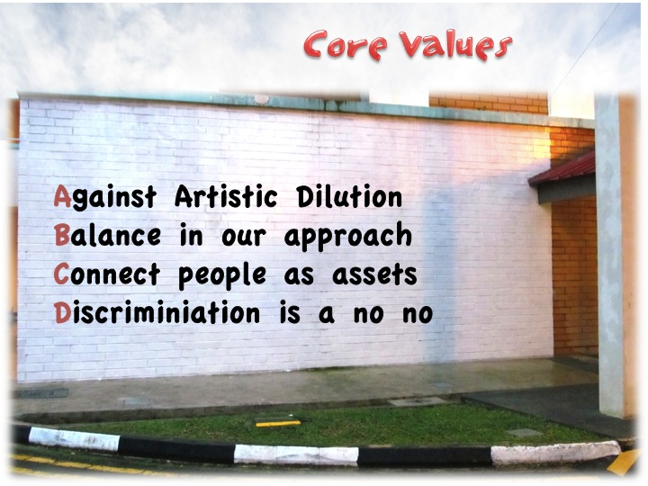
Summary:

